Slide 1
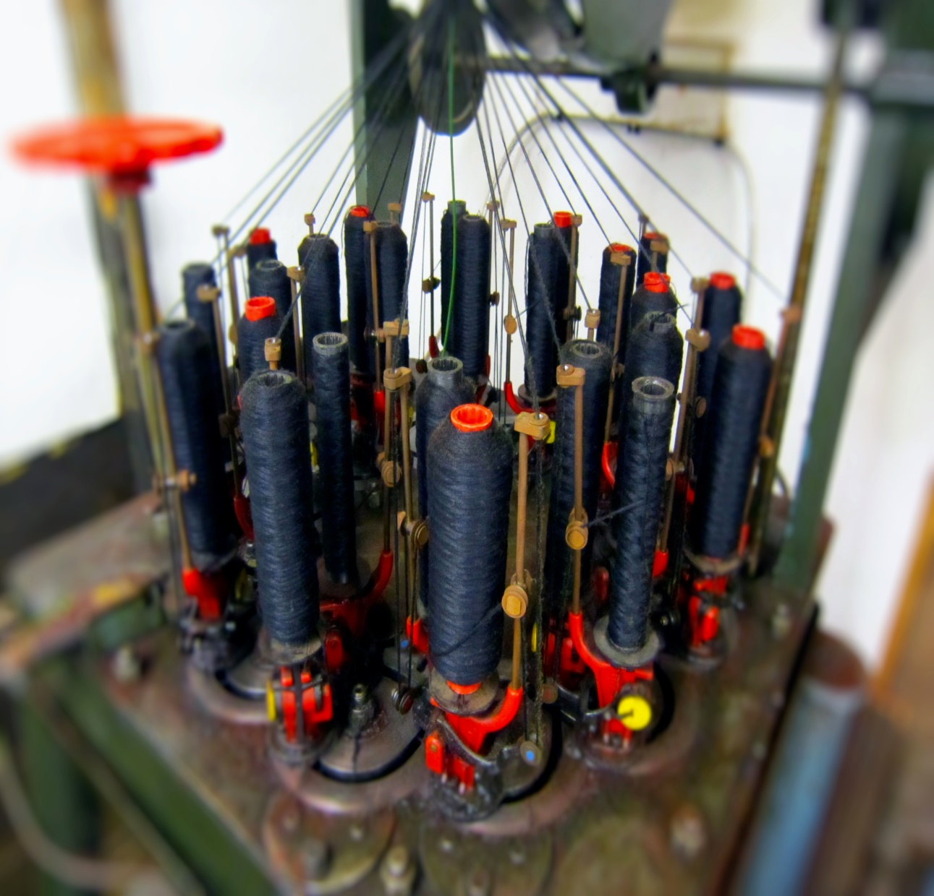
Braided Cable
Authentic braided cable for classic & vintage vehicle restoration
Auto Electric Supplies Ltd
Unit 2 Brights Court
Tenbury Business Park
Bromyard Road
Tenbury Wells
Worcestershire
WR15 8FG
01584 819 552
www.autoelectricsupplies.co.uk

Slide 2
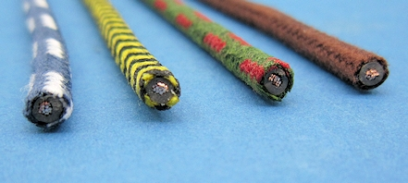
General Braided Cable The colours listed below are stock colours. Any other colours are available subject to a minimum quantity of 30m. (Please call 01584 819552 or contact us by email).
020101
14/0.30, 1.0mm², 8.75A, 3.7mm OD
Black, Black/White Herringbone, Black/Yellow Herringbone
Green, Green/Purple, Green/Red, Green/White
Brown
Purple, Purple/Black
Red
Orange, Orange/Two Black (Alfa)
Blue, Blue/Red, Blue/White, Blue/Yellow
White, White/Black
Yellow, Yellow/Green
Braided cable is an authentic replacement cable for older vehicles such as classic and vintage cars. Manufactured by braiding modern PVC cable and then lacquering. The cable therefore looks like the original but has the electrical and mechanical properties of modern cable.

Slide 3
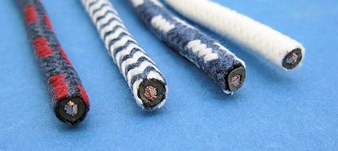
020102
28/0.30, 2.0mm², 17.5A, 4.2mm OD
Black, Black/White Herringbone,
Black/Red Herringbone
Green, Green/Black
Brown, Brown/Blue, Brown/White
Purple, Purple/Black
Red, Red/Black
Orange, Orange/Two Black (Alfa)
Blue, Blue/Red, Blue/White, Blue/Yellow, Blue/White Herringbone
White, White/Black
Yellow

Slide 4
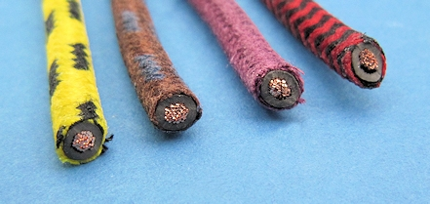
020103
44/0.30, 3.0mm², 27.5A, 4.8mm OD
Black, Black/Red Herringbone
Green
Brown, Brown/Blue, Brown/White
Purple
Red
Orange, Orange/Two Black (Alfa)
Blue, Blue/White Herringbone
White, White/Red
Yellow, Yellow/Black

Slide 5
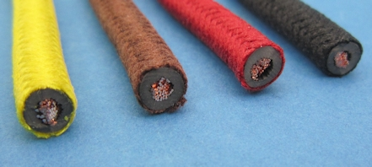
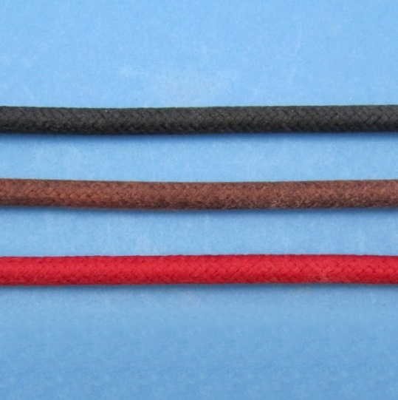
020105
65/0.30, 4.5mm², 35.0A, 5.9mm OD
Black
Brown
Red
Yellow
Orange
Orange/Two Black (Alfa)
020707
120/0.30, 8.5mm², 63.0A - 6.5mm OD
Black
Brown
Red

Slide 6
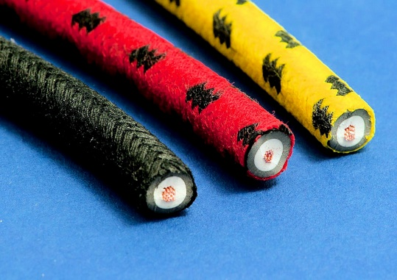
Braided HT Cable
Copper conductors, 7mm diameter
Black
Red
Red/Black
Red/Yellow
Yellow/Black

Slide 7
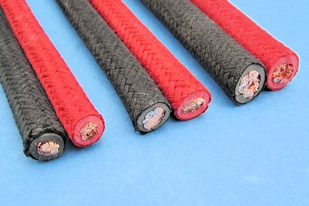
Braided Battery Cable
As per general cable, braided battery cable is modern PVC flexible battery cable that has been braided in cotton and lacquered. Available in either black or red.
020201
206/0.3, 16mm², 9.5mm OD, 110A
020202
196/0.40, 25mm², 11mm OD, 170A
020203
315/0.40, 40mm², 13mm OD, 300A

Slide 8
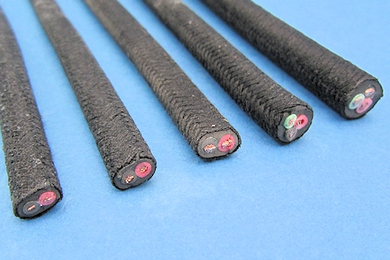
Braided Multicore Cable
PVC insulated single conductors sheathed in black PVC outer, braided in black cotton and lacquered.
020301
2 x 9/0.30 (0.65mm²), 4.6 x 6.7mm OD, 5.75A
020302
2 x 14/0.30 (1mm²), 5 x 7.2mm OD, 8.75A
020303
2 x 28/0.30 (2mm²), 5.4 x 8.2mm OD, 17.50A
020304
3 x 14/0.30 (1mm²), 8.2mm OD, 8.75A
020305
3 x 28/0.30 (2mm²), 9.2mm OD, 17.50A

